Slide 1
The only items you should have at your seat at start of examination are:
An approved calculator (not a “smart” device)
The Scantron 95677 form for marking answers
A No. 2 pencil and eraser to make erasures in case you make mistakes
What is provided for you:
The exam on 3 pages—double-sided. The last page is a blank sheet for scratch calculation
You keep the exam questions (key will be posted)
The Green and Yellow reference sheets (please return these after the exam)
Do NOT have a smart phone/device at all in your hands or in view. It is a violation of College rules & policies.

Slide 2
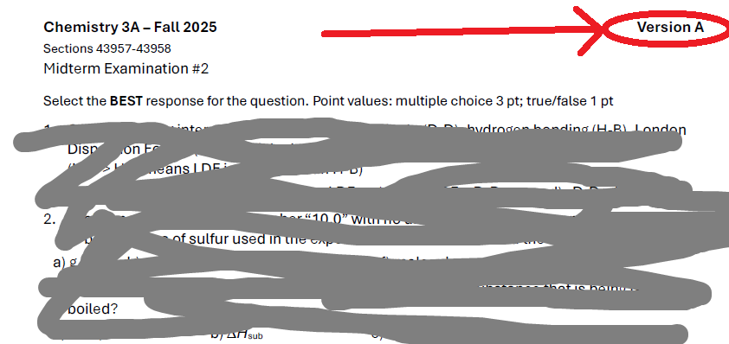
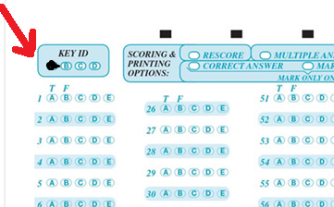
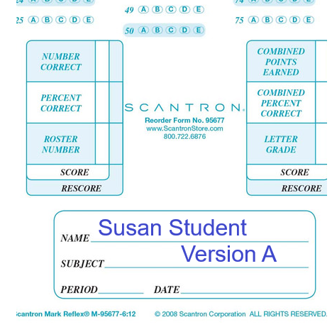
Mark the version written on your Name area AND that you fill in the oval (red arrow) of your Version
Be careful of multiple choice (4 or 5 choices) and the True/False questions
Best wishes for your success

